Slide 1

Gokaraju Rangaraju Institute of Engineering and Technology (Autonomous) Department of Data Science Mini Project Work (CSE(DS))
Review2: Architecture Design Presentation
Batch No - B3
Presented by:
1. B. Karthikeya (22241A6771)
2. B. Abhilash Reddy (22241A6775)
3. B. Sushanth (22241A6776)
Under the Guidance of:
Dr. R.P. Ram Kumar
Professor
CSE(DS) Department

Slide 2
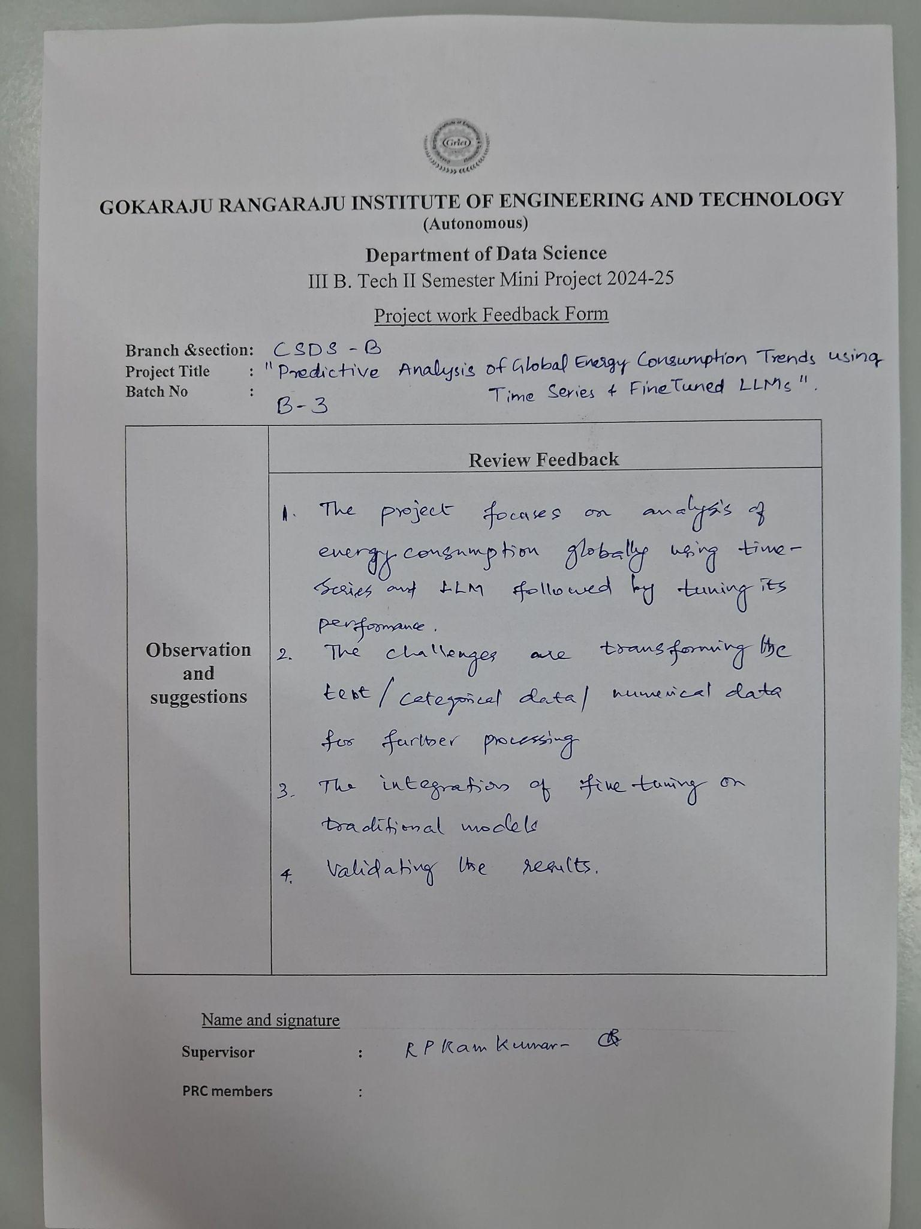
Review 1 Feedback

Slide 3
Abstract
This project focuses on a Comprehensive analysis of Global Energy Trends and their consumption every year using “Time series analysis and fine-tuned LLM models” along with data analysis. This project incorporates enhanced prediction and analysis of “Global Energy” Consumption from Natural Resources like Coal, Oil, Natural Gas, Hydroelectricity and more. This project leverages Time Series Analysis (ARIMA, SARIMA) and Fine-Tuned Large Language Models (LLMs) like Mistral 7b to analyze and predict global energy consumption trends with high accuracy. Using historical energy data from sources like the IEA, World Bank, and BP Statistical Review, the project identifies key consumption patterns across coal, oil, natural gas, and renewables to support informed decision-making and Environmental Sustainability.
‹#›

Slide 4
Literature Review
The summary of the literature review is to be presented in the table given in the next slide.
20 to 25 papers to be reviewed from last 3-4 years only
Pls identify paper that have potential and help in proper understanding. Top tier papers have more weightage and have to be considered for reviews.
‹#›

Slide 5
Literature Review
Source | Research Objective or Research Question | Methodology | Key Findings | Relevance to Project | Techniques | Accuracy & Performance Measures | Advantages | Disadvantages
MDPI Sustainability | Explores ANN applications for predicting building energy consumption. | A review of studies using ANNs for energy consumption prediction. | ANNs, especially MLP and RNN, are effective for energy prediction. | Insights on accuracy and challenges apply to LLM-based forecasting. | Discusses ANN techniques that can be adapted for LLM-based predictions. | MAE, RMSE, and R-squared can also evaluate LLMs for energy prediction. | ANNs' adaptability is similar to LLMs in handling complex data. | Both face challenges like overfitting and high data dependency.
Cornell University | Evaluates the performance of conventional, machine learning, and deep learning models for energy forecasting. | Analytical and empirical assessment using real-world datasets for energy consumption and natural gas. | Machine learning and deep learning methods outperform conventional models in energy forecasting. | Relevant for comparing machine learning methods like LLMs with conventional models in time-series energy forecasting. | Examines techniques like ARIMA, SVM, and deep learning for time series forecasting. | Performance measured using MAE, RMSE, and other standard metrics. | Machine learning models provide better accuracy and scalability for energy forecasting. | Conventional models can be less accurate, and machine learning models require large datasets and high computational power.
ResearchGate | Aims to predict energy consumption using deep learning algorithms, analyzing factors affecting high consumption. | Utilizes deep learning algorithms to predict energy usage in a university setting. | Deep learning models effectively predict energy consumption, considering factors like occupancy and weather. | Insights into deep learning for energy prediction can guide the application of LLMs for global energy forecasting. | Focuses on deep learning techniques for energy consumption prediction. | Evaluates accuracy using MAE, RMSE, and other relevant metrics. | Deep learning models offer high accuracy and adaptability to complex data. | Requires large datasets and significant computational resources for training.
‹#›

Slide 6
Research Gaps
There are not exactly the disadvantages from the previous slides, but rather have to be carefully be identified.
Pls mention it as points.
‹#›

Slide 7
Problem Statement
This is one complete paragraph.
‹#›

Slide 8
Objectives
What and How you are to be reflected in the objectives of the project.
List the specific objectives of the project.
Highlight the research questions or goals of the project.
‹#›

Slide 9
Objectives
‹#›

Slide 10
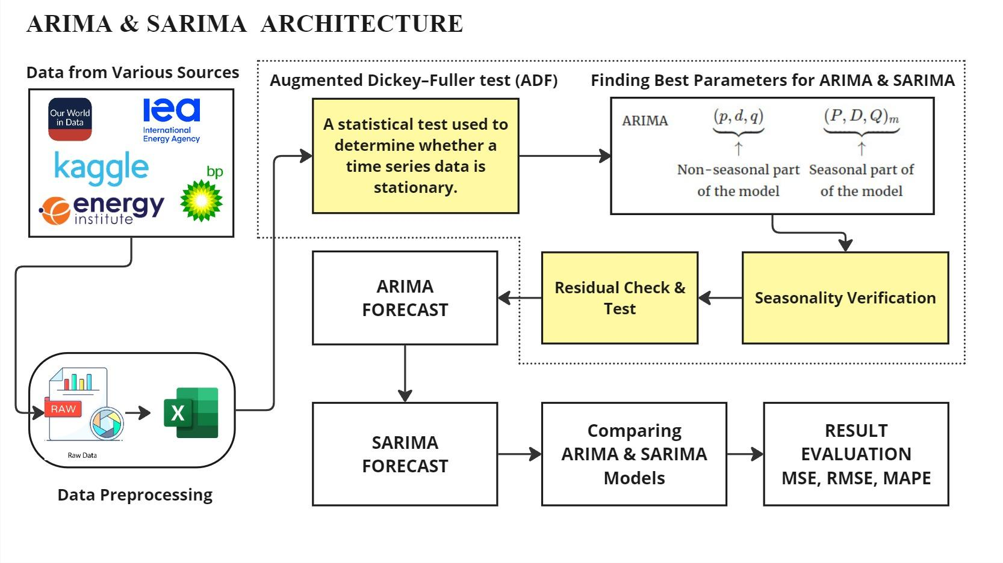
‹#›

Slide 11
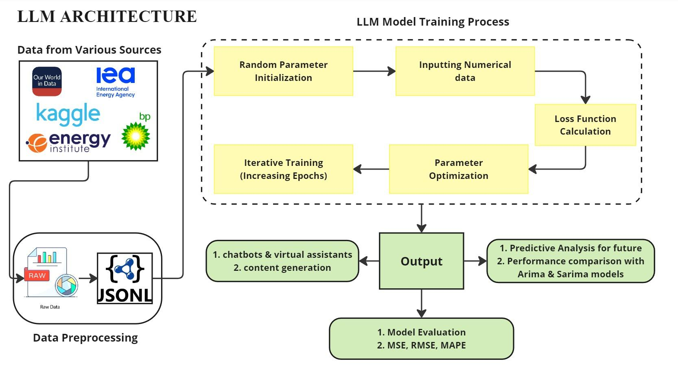
‹#›

Slide 12
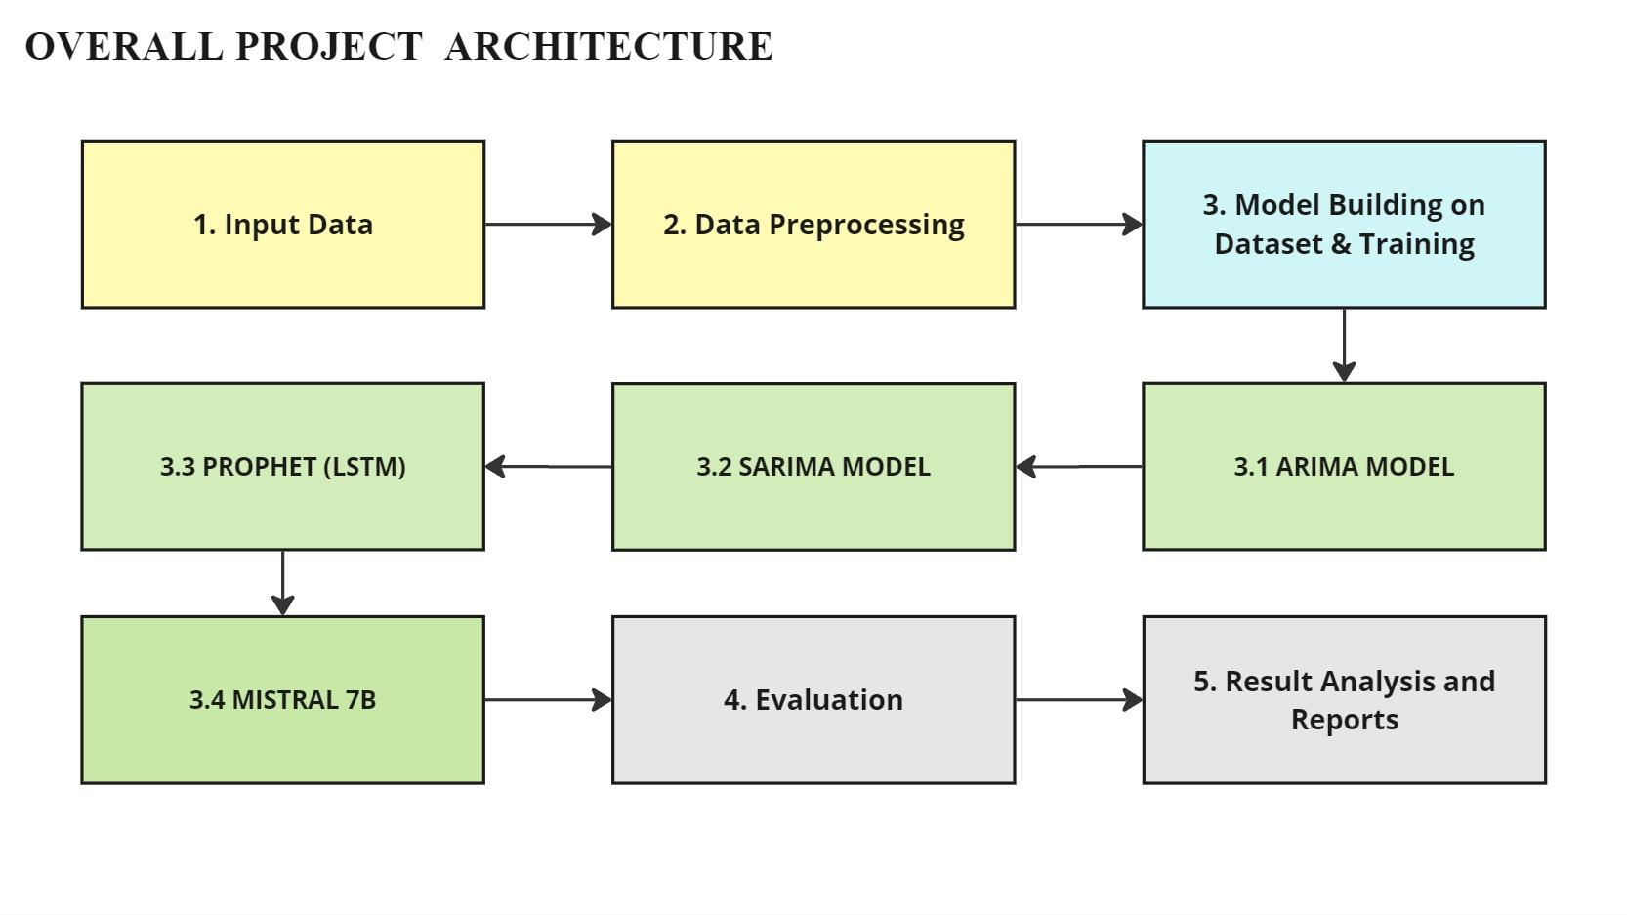
‹#›

Slide 13
Software and Hardware Requirements
SOFTWARE | HARDWARE
Operating System: Windows 10/11, macOS, or Linux (Ubuntu preferred) Programming Languages: Python (preferred), R (optional for statistical modeling) Libraries & Frameworks: Time Series Analysis: statsmodels, prophet Machine Learning: tensorflow, torch Data Processing: pandas, numpy, matplotlib LLM Fine-Tuning & Inference: transformers, bitsAndBytes, accelerate | CPU: Intel Core i7/i9 (12th Gen or later) or AMD Ryzen 7/9 (5000 series or later) RAM: Minimum 16GB GPU: NVIDIA RTX 3090/4090, T4 GPU (for fine-tuning LLMs) Cloud GPU Access: Google Colab, Kaggle Storage: SSD (Minimum 1TB) Network: High-speed internet (for cloud-based LLM training & data fetching)
‹#›

Slide 14
Datasets Details
1. Coal Consumption Dataset
https://ourworldindata.org/grapher/coal-consumption-by-country-terawatt-hours-twh
2. Natural Gas Consumption Dataset
https://ourworldindata.org/grapher/natural-gas-consumption-by-region
3. Oil Consumption Dataset
https://ourworldindata.org/grapher/oil-consumption-by-country
Size of the Datasets: 5522 rows Each including 73 Countries and 31 Regions.
Attributes:
Entity: Categorical attribute (Country or Region).
Year: Numerical attribute (Integer, representing the year).
Consumption (TWh): Numerical attribute (Floating point, representing energy consumption in TWh).
Sources: Statistical Review of World Energy, Our World in Data.
‹#›

Slide 15
References
Write all the literature review papers in this format.
Example:
A. B. Amjoud and M. Amrouch, "Object Detection Using Deep Learning, CNNs and Vision Transformers: A Review," in IEEE Access, vol. 11, pp. 35479-35516, 2023
‹#›

Slide 16
Thank you
‹#›

